Slide 1

Expectation
AKA “mean” of the RV or the distribution
Interpretations
Center of gravity of the PMF
Average in large number of repetitions of the experiment

Slide 2
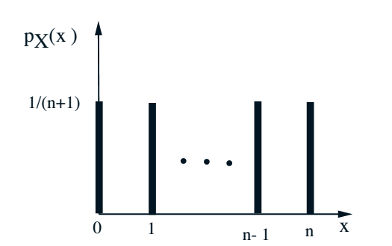
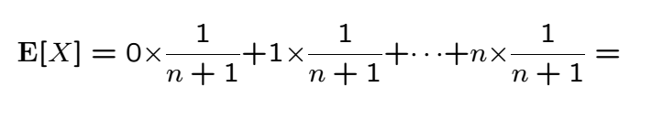
Example: Uniform PMF

Slide 3




Example: Geometric PMF
Pulling the p out of the sum and using math identity
Math identity can be derived by differentiating the geometric sum formula

Slide 4
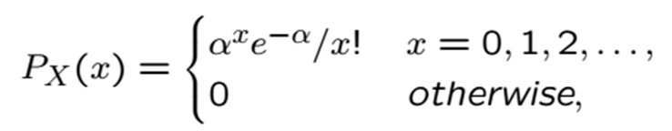


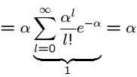
Example: Poisson PMF
Last sum is 1 because

Slide 5
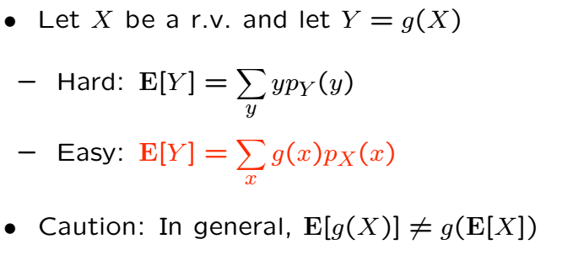
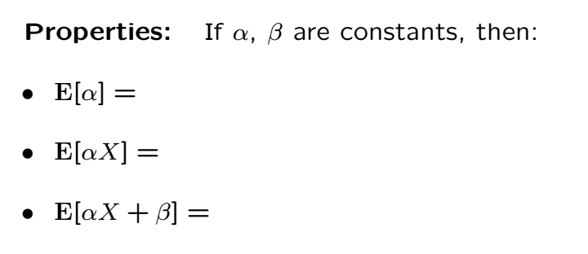
Properties of Expectations

Slide 6



Other Examples without Proofs
Binomial (n,p)
Pascal (k,p)
Uniform (k,l)

Slide 7
Acknowledgements and Citations
Parts of these slides are adapted from the following resources:
Power Point Lecture Slides for the Textbook http://bcs.wiley.com/hebcs/Books?action=index&bcsId=8676&itemId=1118324560
John Tsitsiklis. 6.041 Probabilistic Systems Analysis and Applied Probability, Fall 2010. (Massachusetts Institute of Technology: MIT OpenCourseWare),http://ocw.mit.edu (Accessed 13 Apr, 2015). License: Creative Commons BY-NC-SA

